Slide 1
Endocrine System

Slide 2
Slide 9.1
The Endocrine System
Second messenger system of the body
Uses chemical messages (hormones) that are released into the blood
Hormones control several major processes
  Reproduction
  Growth and development
  Mobilization of body defenses
  Maintenance of much of homeostasis
  Regulation of metabolism
Copyright © 2003 Pearson Education, Inc. publishing as Benjamin Cummings

Slide 3
Slide 9.2
Hormone Overview
Hormones are produced by specialized cells
Cells secrete hormones into extracellular fluids
Blood transfers hormones to target sites
These hormones regulate the activity of other cells
Copyright © 2003 Pearson Education, Inc. publishing as Benjamin Cummings

Slide 4
Slide 9.3
The Chemistry of Hormones
Amino acid-based hormones
  Proteins
  Peptides
  Amines
Steroids – made from cholesterol
Prostaglandins – made from highly active lipids
Copyright © 2003 Pearson Education, Inc. publishing as Benjamin Cummings

Slide 5
Slide 9.4
Mechanisms of Hormone Action
Hormones affect only certain tissues or organs (target cells or organs)
Target cells must have specific protein receptors
Hormone binding influences the working of the cells
Copyright © 2003 Pearson Education, Inc. publishing as Benjamin Cummings

Slide 6
Slide 9.5
Effects Caused by Hormones
Changes in plasma membrane permeability or electrical state
Synthesis of proteins, such as enzymes
Activation or inactivation of enzymes
Stimulation of mitosis
Copyright © 2003 Pearson Education, Inc. publishing as Benjamin Cummings

Slide 7
Slide 9.10
Control of Hormone Release
Hormone levels in the blood are maintained by negative feedback
A stimulus or low hormone levels in the blood triggers the release of more hormone
Hormone release stops once an appropriate level in the blood is reached
Copyright © 2003 Pearson Education, Inc. publishing as Benjamin Cummings

Slide 8
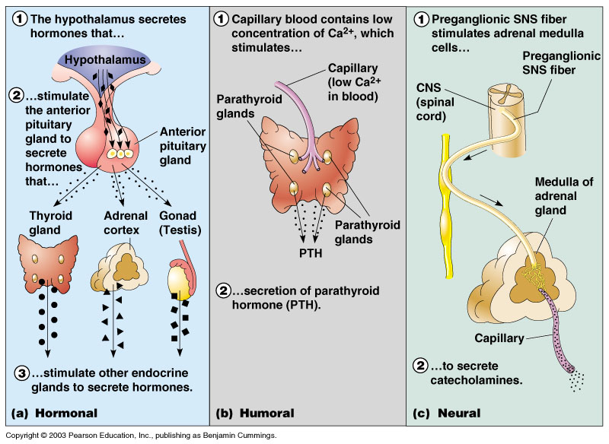
Slide 9.11
Hormonal Stimuli of Endocrine Glands
Endocrine glands are activated by other hormones
Figure 9.2a
Copyright © 2003 Pearson Education, Inc. publishing as Benjamin Cummings

Slide 9
Slide 9.12
Humoral Stimuli of Endocrine Glands
Changing blood levels of certain ions stimulate hormone release
Figure 9.2b
Copyright © 2003 Pearson Education, Inc. publishing as Benjamin Cummings

Slide 10
Slide 9.13
Neural Stimuli of Endocrine Glands
Nerve impulses stimulate hormone release
Most are under control of the sympathetic nervous system
Figure 9.2c
Copyright © 2003 Pearson Education, Inc. publishing as Benjamin Cummings

Slide 11
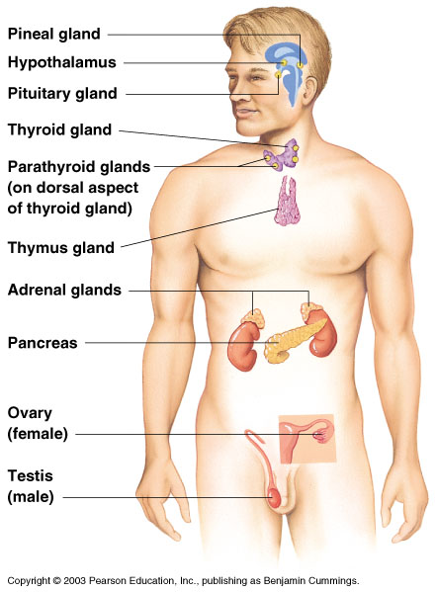
Slide 9.14
Location of Major Endrocrine Organs
Figure 9.3
Copyright © 2003 Pearson Education, Inc. publishing as Benjamin Cummings

Slide 12
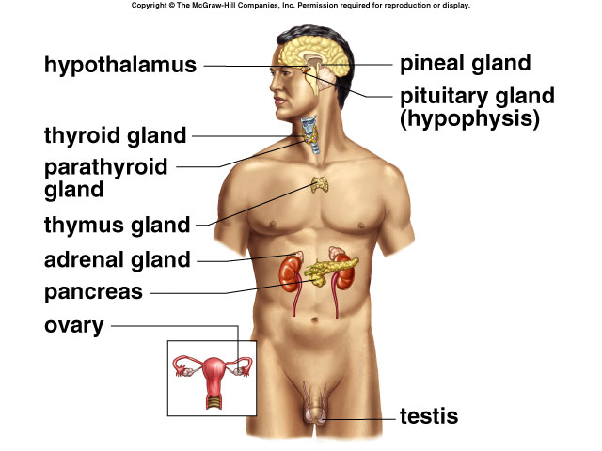

Slide 13
Endocrine System – Some Basic Principles
Hormone secretion rates are controlled by
Negative feedback systems
Positive feedback systems
Presence of an antagonistic hormone
(hormones that bring the body back to a normal state)

Slide 14
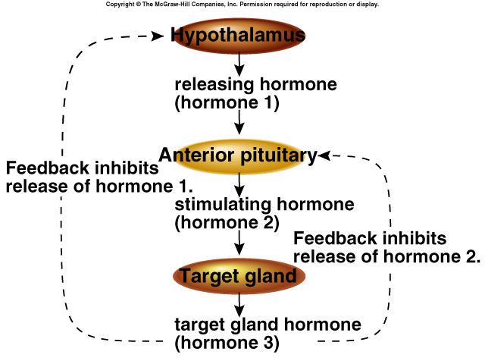

Slide 15
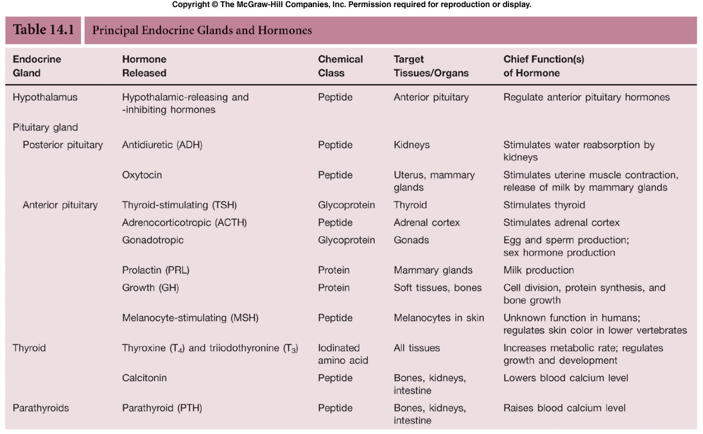

Slide 16
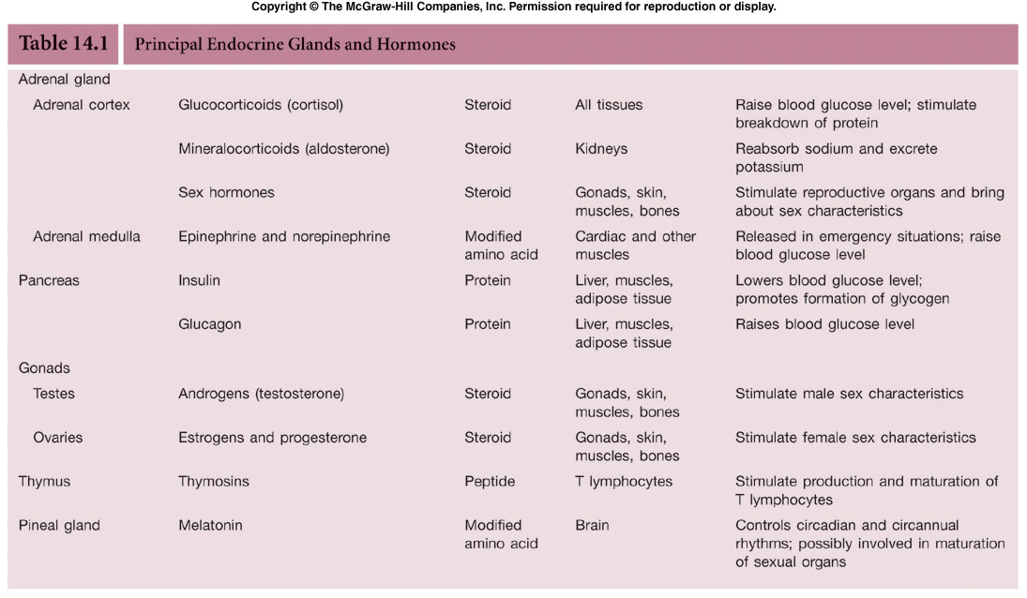

Slide 17
Hypothalamus and Pituitary Gland
Hypothalamus (a part of the brain) regulates the internal environment through the autonomic nervous system.
  Also controls glandular secretions of the pituitary gland (the “master gland”) through releasing / inhibiting hormones.

Slide 18
Anterior Pituitary
  Anterior pituitary also produces:
    Thyroid Stimulating Hormone (TSH). Adrenocorticotropic Hormone (ACTH). Gonadotropic Hormones (FSH and LH). Prolactin (PRL). Melanocyte-Stimulating Hormone (MSH).
    Growth Hormone (GH). . . .
    Dwarf / giant vs. acromegaly.

Slide 19
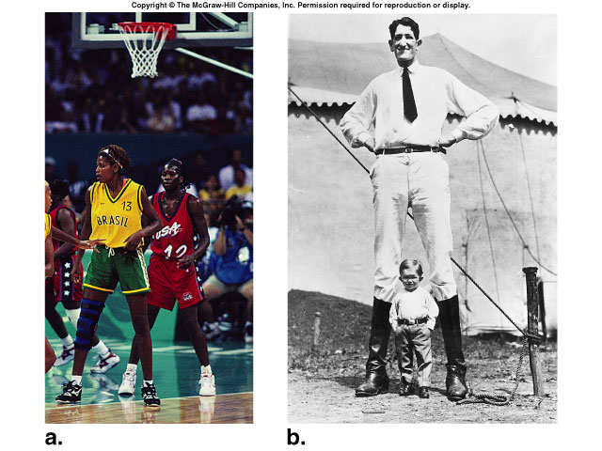

Slide 20
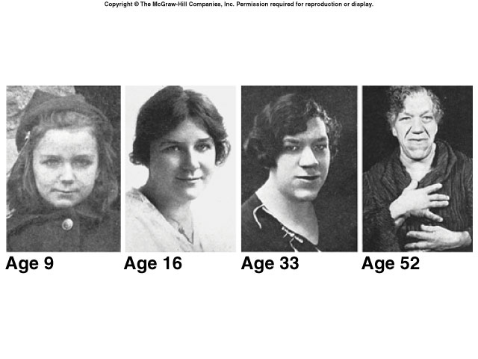

Slide 21
Posterior Pituitary
Posterior pituitary releases two hormones produced by the hypothalamus.
Antidiuretic hormone (ADH).
  Controls levels of water expelled in urine.
  . Negative feedback control
Oxytocin. Causes uterine contraction during childbirth and milk letdown.
    . Positive feedback control

Slide 22
HORMONES OF METABOLISM
Thyroid / Parathyroid Glands
The thyroid gland actively acquires iodine to thyroxine (T₄) . . . .
Thyroxine controls the rate of metabolism in cells. (incr. thyroxine = incr. metabolism)

Slide 23
Adrenal Glands
Each adrenal gland consists of an adrenal cortex (outer layer) and an adrenal medulla (inner layer, core).
  Epinephrine (adrenalin)and norepinephrine (noradrenalin) are produced by the adrenal medulla and rapidly bring about bodily changes when an individual reacts to an emergency.
  The “fight or flight” response (stress response).

Slide 24
Adrenal Glands
The adrenal cortex produces glucocorticoids such as cortisol and cortisone which raise blood glucose levels and counteract the inflammatory response – thus, relieving swelling and pain from inflammation.
- Also produces the mineralocorticoids, such as aldosterone, which promotes Na⁺ absorption and K⁺ excretion by the kidneys.

Slide 25
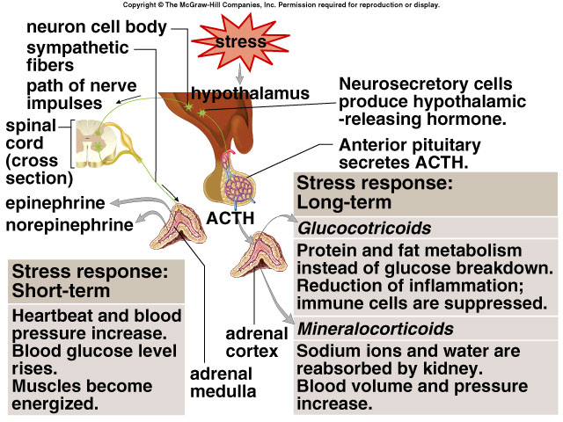

Slide 26
Pancreas
The pancreas is composed of two tissue types.
  Exocrine tissue produces and secretes digestive juices.
  Endocrine tissue, islets of Langerhans (pancreatic islets), produces and secretes insulin and glucagon directly into the blood.
    Antagonistic hormones which regulate blood sugar levels.

Slide 27
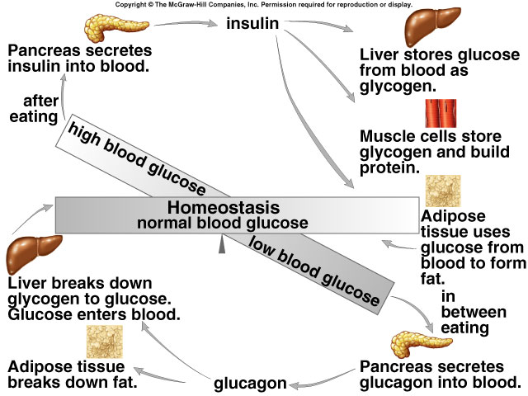

Slide 28
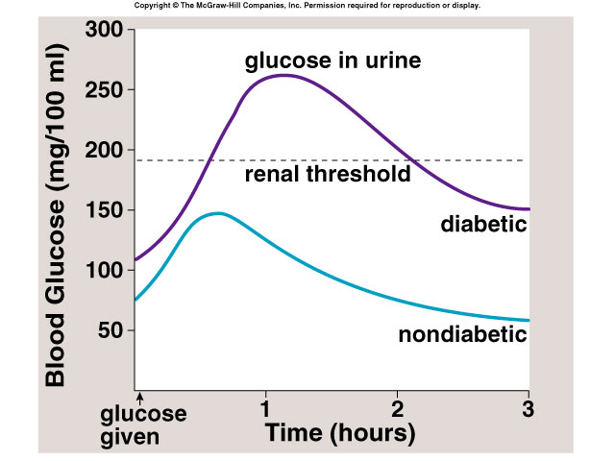

Slide 29
Hormones of Digestion, Sex, and Immune System
Digestion - gut hormones.
Sex hormones . . . .
Testes
  produce androgens (testosterone).
  Ovaries
  produce oestrogens and progesterone.
    Puberty - secondary sexual characteristics.

Slide 30
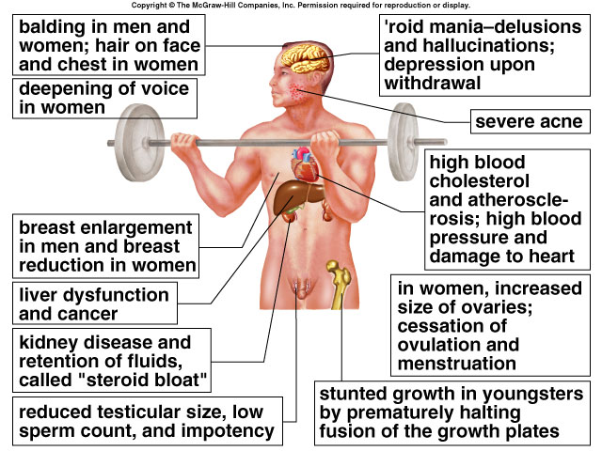

Slide 31
Other Endocrine Glands
Pineal Gland.
  Secretes melatonin that is involved in regulating daily sleep-wake cycle (circadian rhythms).

Slide 32
Homeostasis / Environmental Signals
There are hormones produced from other tissues not considered endocrine glands . . .
Leptin produced by fat cells which signal satiety.
Growth factors Stimulate cell division and mitosis.
Prostaglandins which act locally between cells.

Slide 33
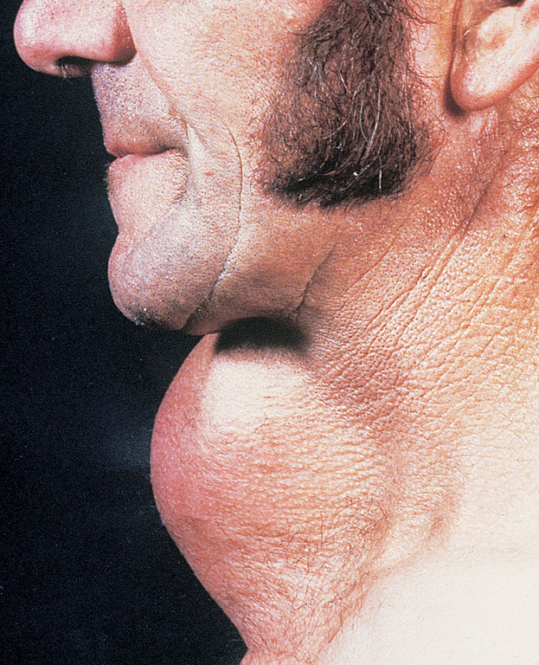
Goitre

